Slide 1
Junior Angular Developer Certification

Slide 2
What is Angular
Angular is a web framework that empowers developers to build fast, reliable applications.
Maintained by a dedicated team at Google, Angular provides a broad suite of tools, APIs, and libraries to simplify and streamline your development workflow. Angular gives you a solid platform on which to build fast, reliable applications that scale with both the size of your team and the size of your codebase.

Slide 3


AngularJS vs Angular
AngularJS
Angular
AngularJS (2010)
Angular (2016)
First version of Angular
Started as Angular 2. Nowadays (2024) we are at version 18.

Slide 4
TypeScript

Slide 5
What is TypeScript
TypeScript is JavaScript with syntax for types.
TypeScript is a strongly typed programming language that builds on JavaScript, giving you better tooling at any scale.

Slide 6
TypeScript
Primitives
string
number
boolean
Arrays
string[] -> [‘One’, ‘Two’, ‘Three’]
number[] -> [1, 2, 3]
boolean[] -> [true, false, true]
class Point {
x: number;
y: number;
}
const pt = new Point();
pt.x = 0;
pt.y = ‘1’;
Classes

Slide 7
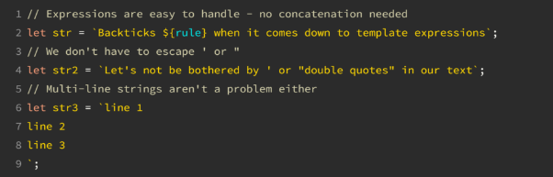
TypeScript - Backticks
Backticks are superior most of the time because they were designed to make template strings easy:

Slide 8
Angular CLI

Slide 9
Angular CLI
The Angular CLI is a command-line interface tool which allows you to scaffold, develop, test, deploy, and maintain Angular applications directly from a command shell.
Commonly used CLI commands:
ng new app-name
ng serve
ng test
ng deploy
ng generate <type> <name>

Slide 10
Naming conventions
File naming convention
my-hero.component.ts
my-hero.component.html
my-hero.component.css (or scss)
my-hero.component.spec.ts
Main application
AppModule
AppComponent
General naming guidelines
logger.service.ts
custom-string.pipe.ts
styling.directive.ts
custom-child.module.ts

Slide 11
Modules

Slide 12
Modules
NgModules configure the injector, the compiler and help organize related things together.
An NgModule is a class marked by the @NgModule decorator. @NgModule takes a metadata object that describes how to compile a component's template and how to create an injector at runtime. It identifies the module's own components, directives, and pipes, making some of them public, through the exports property, so that external components can use them. @NgModule can also add service providers to the application dependency injectors.

Slide 13
Feature Modules
Feature modules are NgModules for the purpose of organizing code.
A feature module is an organizational best practice, as opposed to a concept of the core Angular API. A feature module delivers a cohesive set of functionality focused on a specific application need such as a user workflow, routing, or forms. While you can do everything within the root module, feature modules help you partition the application into focused areas. A feature module collaborates with the root module and with other modules through the services it provides and the components, directives, and pipes that it shares.

Slide 14
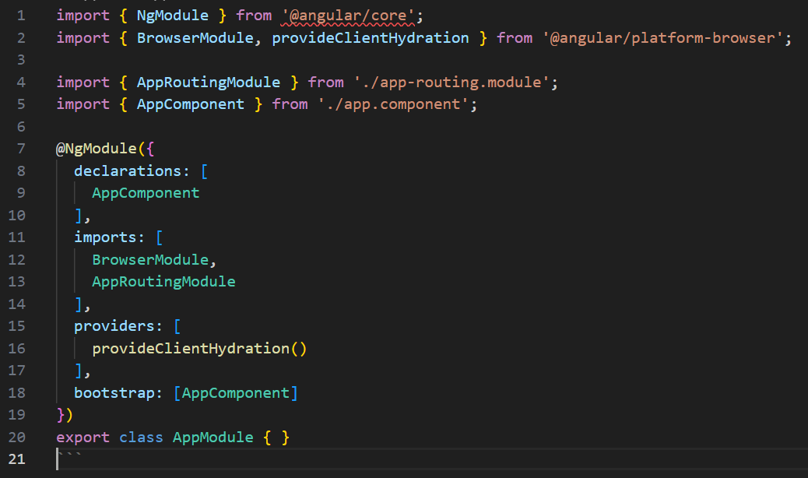
Module Structure

Slide 15
Components

Slide 16
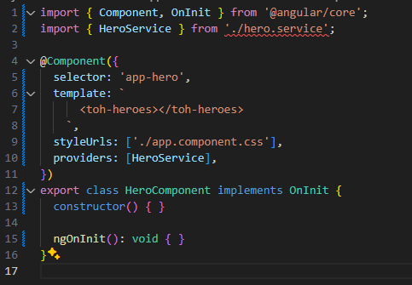
Component Structure

Slide 17
Component – Bindings
Text Interpolation
{{ stringVariable }}
{{ booleanVariable ? textVariable : ‘N/A’ }}
{{ objectVariable }}
One-Way Data Binding
Property Binding
<img alt="item 2" [src]="itemImageUrl“ />
Event Binding
<button type=“text” (click)=“performAction()“ >Submit</button>
Two-Way Data Binding
<input type=“text” [(ngModel)]=“textVariable” />

Slide 18
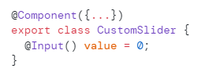



Component Communication
@Input decorator
(props)
@Output decorator
(events)

Slide 19
Services

Slide 20


Services – Definition
VS

Slide 21
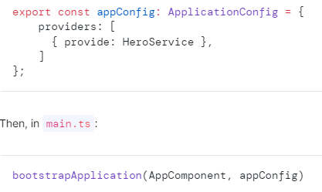
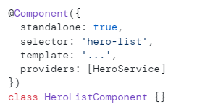
Services – Provide

Slide 22


Services – Dependency Injection
VS

Slide 23
Services – When to use them?
Do limit logic in a component to only that required for the view. All other logic should be delegated to services.
Do move reusable logic to services and keep components simple and focused on their intended purpose.
Why? Logic may be reused by multiple components when placed within a service and exposed as a function.
Why? Logic in a service can more easily be isolated in a unit test, while the calling logic in the component can be easily mocked.
Why? Removes dependencies and hides implementation details from the component.
Why? Keeps the component slim, trim, and focused.

Slide 24
Directives

Slide 25
Directives – Structural vs Attribute
Attribute Directives:
Attribute directives are responsible for changing the behavior or appearance of an element, component or directive. Attribute directives are defined using the @Directive decorator and can be used by adding the directive name as an attribute to an element.
Structural Directives:
Structural directives are responsible for changing the structure of the DOM element to which they are attached. They do this by adding or removing elements or altering the layout of elements within the DOM. Structural directives are defined using the @Directive decorator with a leading asterisk (*) in the directive selector and can be used by adding the directive name as an attribute to an element.

Slide 26
*ngIf & *ngFor
*ngIf
A structural directive that conditionally includes a template based on the value of an expression coerced to Boolean. When the expression evaluates to true, Angular renders the template provided in a then clause, and when false or null, Angular renders the template provided in an optional else clause. The default template for the else clause is blank.
*ngFor
A structural directive that renders a template for each item in a collection. The directive is placed on an element, which becomes the parent of the cloned templates.
The ngForOf directive is generally used in the shorthand form *ngFor. In this form, the template to be rendered for each iteration is the content of an anchor element containing the directive.

Slide 27
Built-in directives
NgClass
NgStyle
NgModel
NgIf
NgFor
NgSwitch

Slide 28
Router

Slide 29
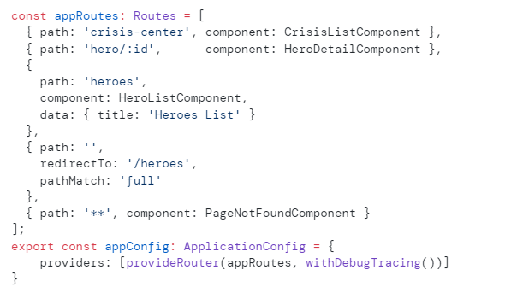
Router Configuration

Slide 30

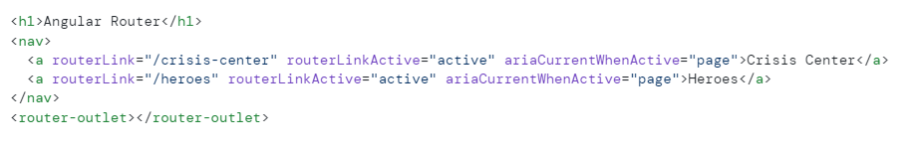
Router Outlet
Router Links

Slide 31
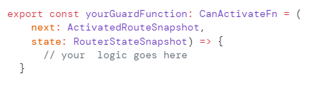
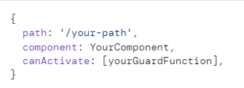
Router Guards

Slide 32
Pipes

Slide 33
Pipes
Pipes are simple functions to use in templates to accept an input value and return a transformed value. Pipes are useful because you can use them throughout your application, while only declaring each pipe once.
Built-in Pipes:
DatePipe
UpperCasePipe
LowerCasePipe
CurrencyPipe
DecimalPipe
PercentPipe
AsyncPipe
JsonPipe

Slide 34
Forms

Slide 35
Forms – Reactive vs Template
People are often conflicted when it comes down to forms with Angular. Should we use template-driven forms or reactive forms?
Here’s a simple answer:
If your form is dynamic (meaning: if the user selects this option, then add/enable or remove/disable other form elements) or will rely on RxJs for reactivity (meaning: auto-complete features or on-the-fly validation of user input using HTTP requests), then use reactive forms.
In all other scenarios, template-driven forms should be perfectly fine.

Slide 36

Forms – AbstractControl class
FormGroup
FormControl
FormArray
Defines a fixed set of controls that can be managed together.
Defined a property of a FormGroup / FormArray
Defines a dynamic form, where controls can be added and removed at run time.
You can define multiple FormControls / FormArrays as part of the FormGroup.
Values can be code-updated with
FormArrays does not have a fixed set of controls. Controls can be added on the fly based on actions.
Each FormControls / FormArrays must have a named key

Slide 37
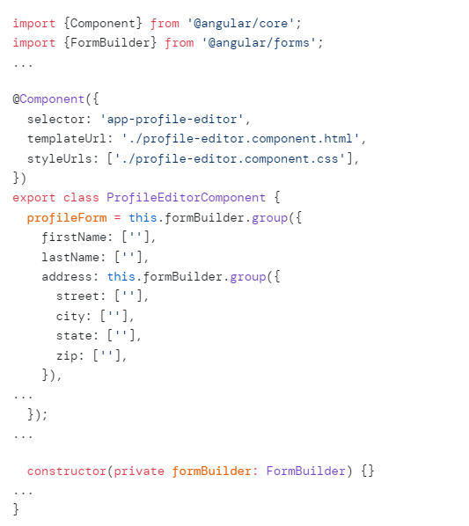
Forms – FormBuilder
FormBuilder is a service that provides convenient methods of generating controls.

Slide 38
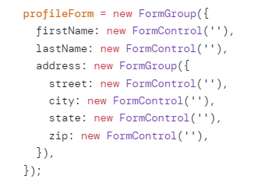
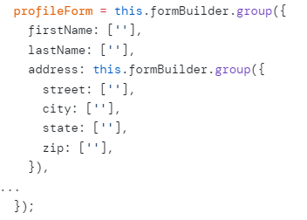
Forms – Instances vs FormBuilder
VS

Slide 39
Forms – Angular CSS Classes
Angular adds its predefined CSS classes to form elements based on their current state. These classes will update as the form state changes.
Some of the classes that Angular uses are:
ng-valid
ng-invalid
ng-pristine
ng-dirty
ng-touched
ng-untouched

Slide 40
Signals

Slide 41
Signals
Angular Signals is a system that granularly tracks how and where your state is used throughout an application, allowing the framework to optimize rendering updates. Signals can contain any value, from primitives to complex data structures.
Signals may be either writable or read-only.

Slide 42




Signals – Examples

Slide 43
Q&A

Slide 44
Appendix
https://www.typescriptlang.org/
https://angular.dev/
https://certificates.dev/angular/dashboard/guides/angular-junior-developer
https://www.angulartraining.com/daily-newsletter
https://medium.com/@abhishek96pundir10/attribute-and-structural-directives-in-angular-a83ccc8e8bcf

